Slide 1

Manufacturing Downtime Analysis Project
DEPI_4 Data Analysis Microsoft Power BI Specialist

Slide 2
Agenda
1) Team Members
2) Project Overview
3) Data Analysis Steps
4) Collecting Data
5) Questions we will Answer
6) Cleaning
7) Modeling
8) Feature Engineering (Dax)
9) Sample Visuals
10) Visualization Reports
11) Visualization Dashboard
12) Insights we Extract from Analysis

Slide 3

1)Team Members
Abram sobhy bekhit
Osama Khalil Abdel Fadil
Youssef Basher El-Sayed
Fady Milad Sadeq
Jana Ehab Mohamed

Slide 4
2) Project Overview
This project analyzes manufacturing production data to identify the main causes of production downtime and improve operational efficiency.
The dataset includes information about production batches, operators, products, production times, and downtime factors affecting the production line.
Using Power BI, the data was cleaned, transformed, and analyzed to build interactive dashboards that help monitor production performance, detect delays, identify the most common downtime causes, and evaluate operator performance.
The main goal of the project is to support better business decisions and reduce production downtime by discovering useful patterns and operational issues.

Slide 5
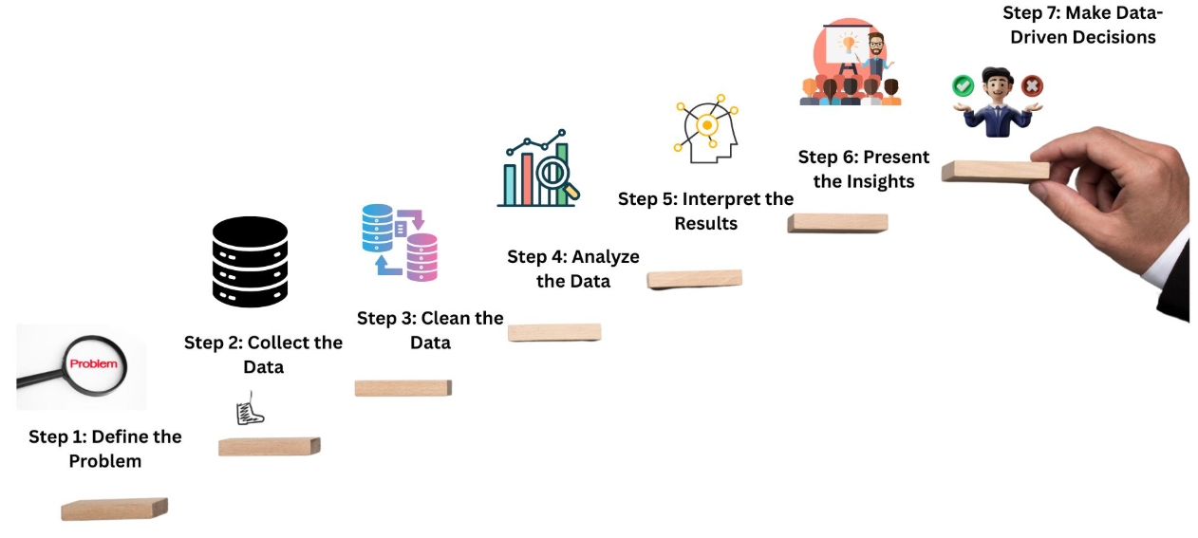
3) Data Analysis Steps
5) Sample Visual
6) Reports
7) Dashboard
8) Insights
1) Collecting Data
2) Cleaning
3) Modeling
4) Dax

Slide 6

4) Collecting Data
We collected data from DEPI.
This data allows us to perform proper data cleaning, including handling missing values, correcting names, detecting inconsistencies , calculating durations, identifying outliers, and validating ranges.
The goal is to ensure high-quality, consistent data for reliable analysis.
Ultimately, this supports data-driven decisions to improve machine productivity.

Slide 7

5) Questions We need to Answer
Key Business Questions
• Are we meeting the expected production targets and batch times?
• When does production performance drop during the day or shifts?
• What are the main reasons behind production delays and downtime?
• How do operators affect production efficiency and delay rates?

Slide 8
6) Data Cleaning
Samples of what we made in data cleaning :
1/we Appropriate columns data types to avoid any errors
2/from filter we unselect null values from end time column
3/we replace blank values in operator column with unknown
4/we transform table downtime to "unpivot shape" to be in appropriate dimension for analysis
5/we transform values in product column with standard name to each product
6/Remove Duplicate Rows from Downtime Table

Slide 9
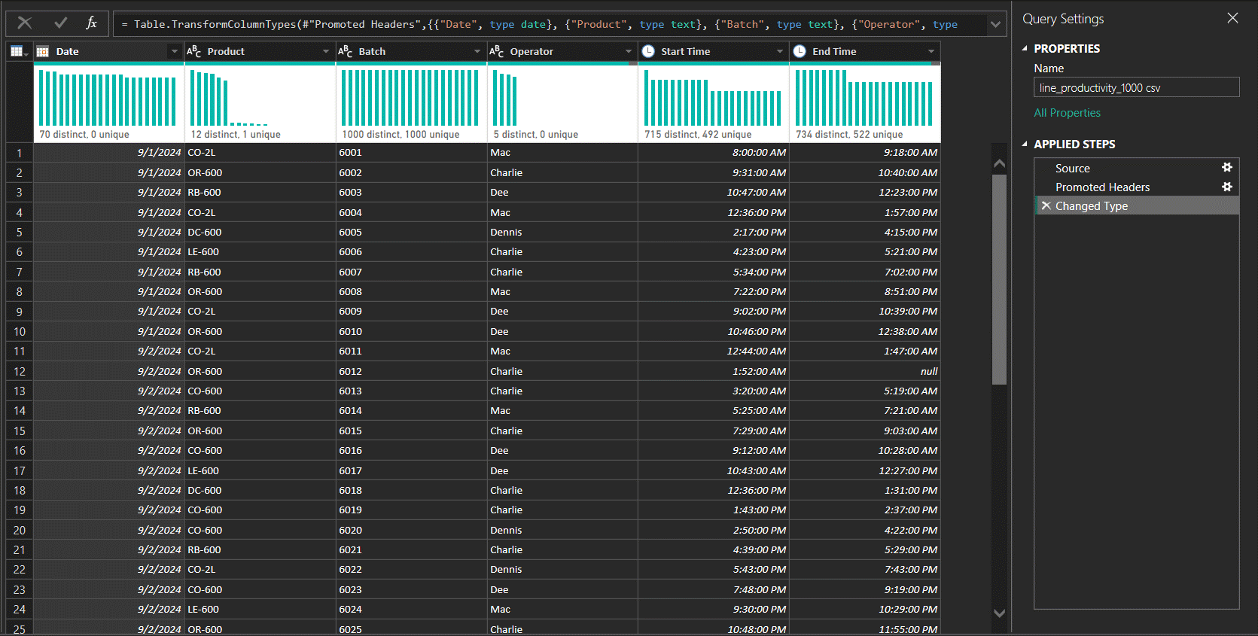
Before

Slide 10
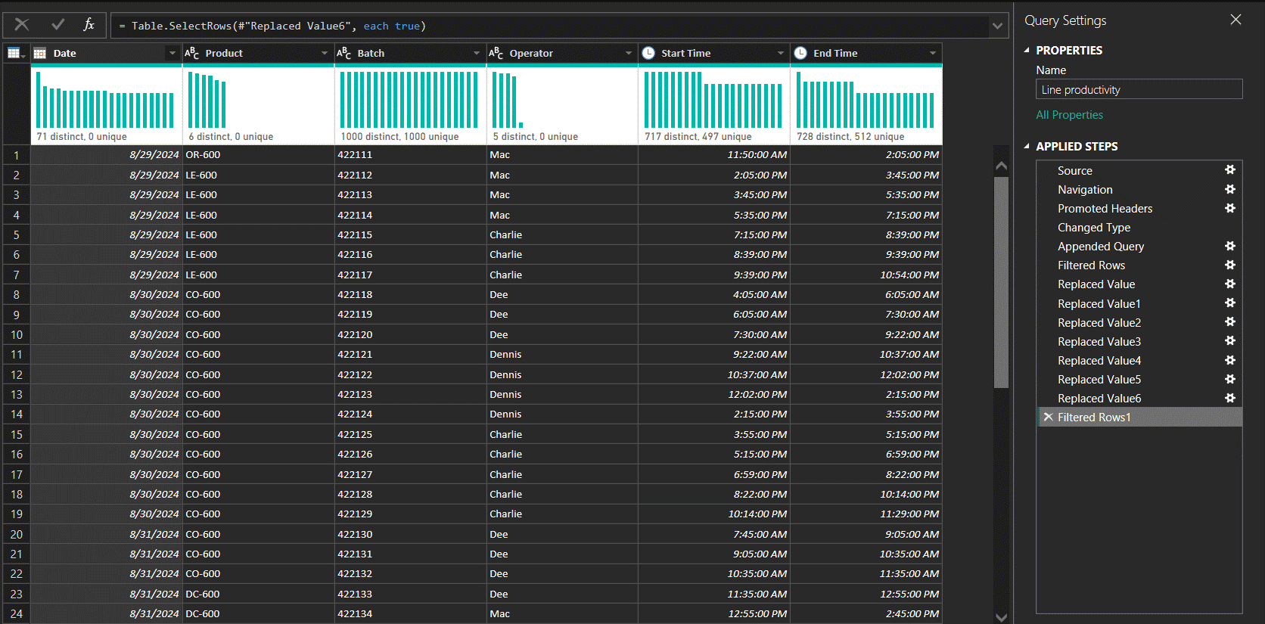
After

Slide 11
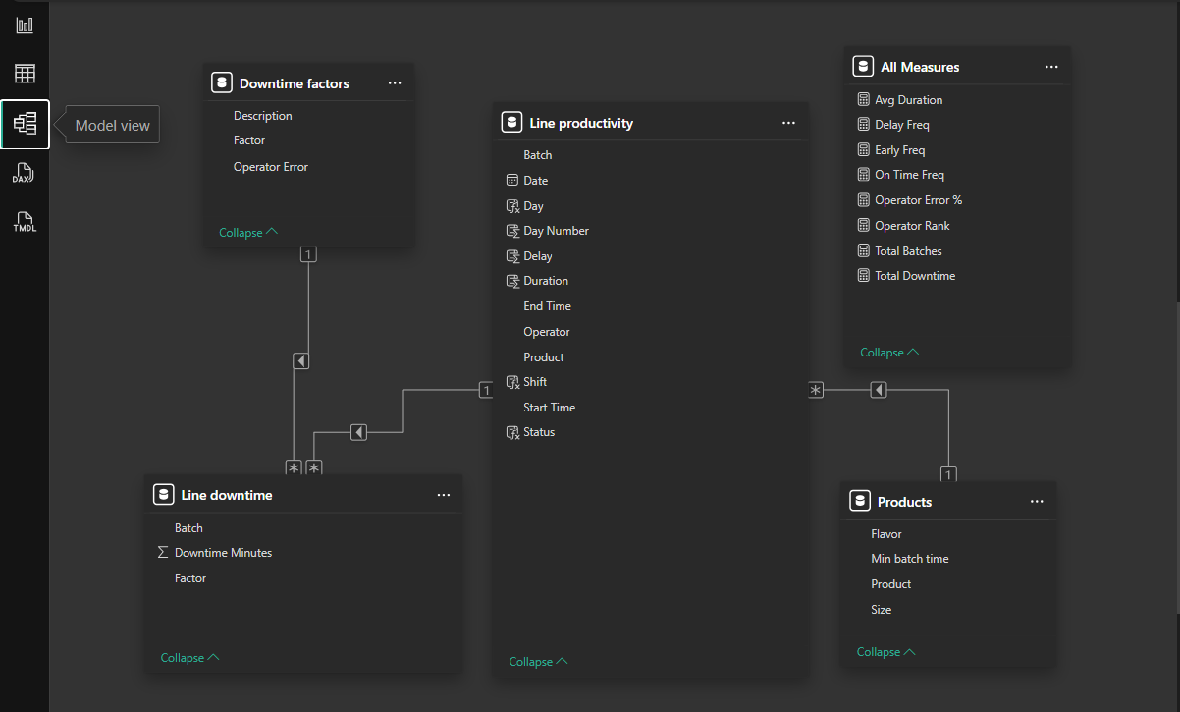
7) Data Modeling

Slide 12
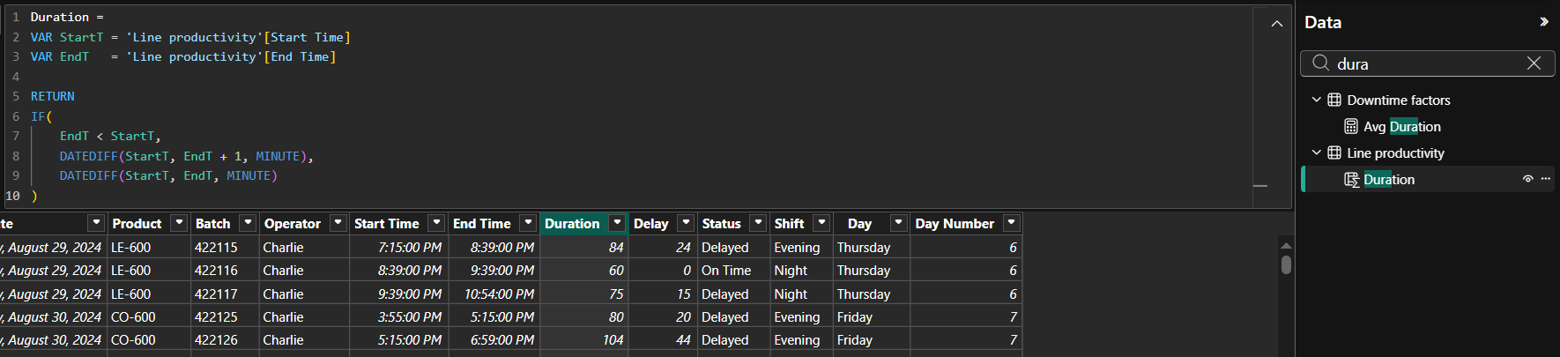
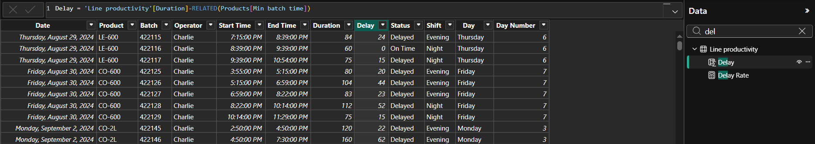
8) Data Analysis Expressions (DAX)
1) DAX By Calculated Columns

Slide 13
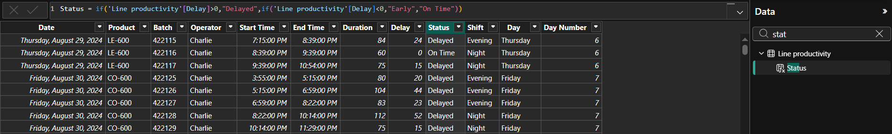
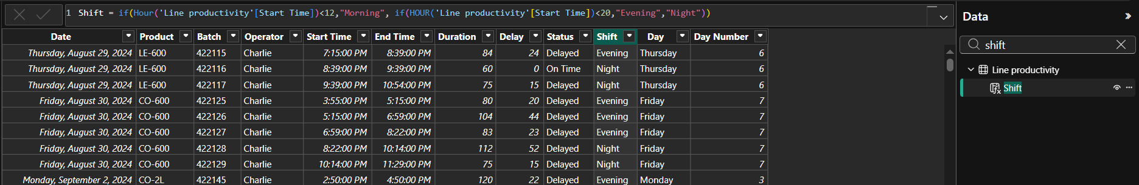
DAX

Slide 14
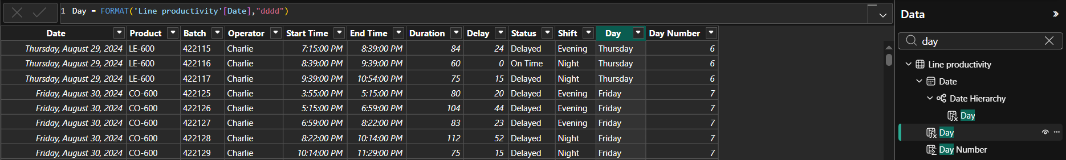
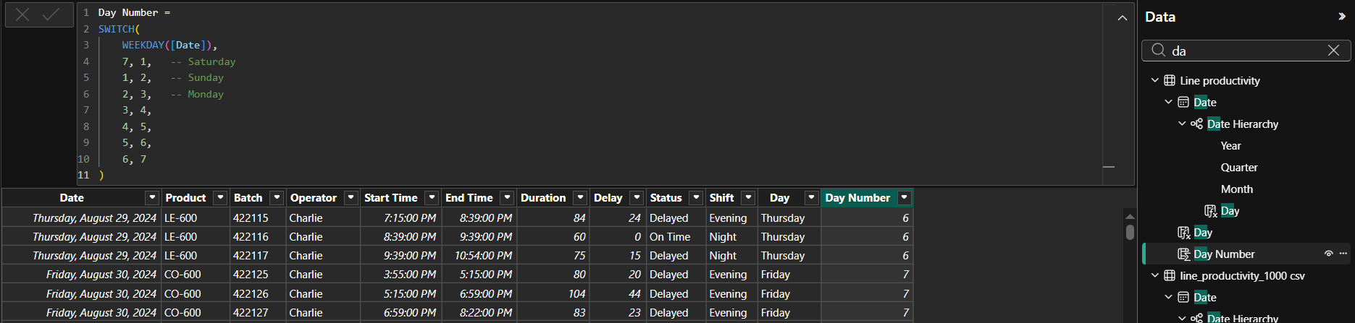
DAX

Slide 15
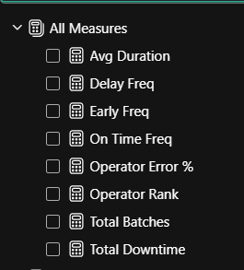
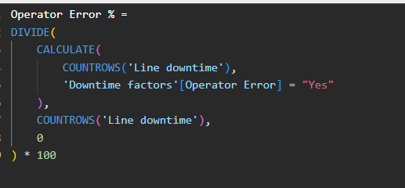
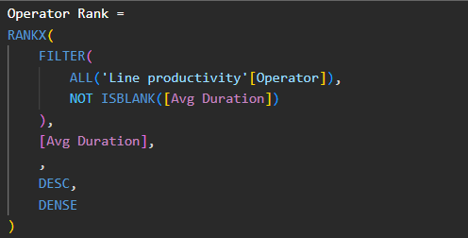
2) DAX By Measures

Slide 16
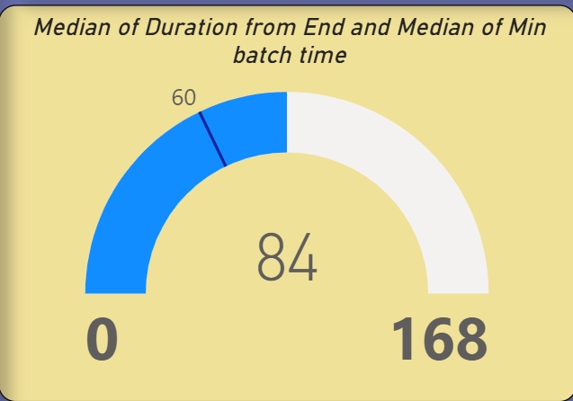
9) Sample Visuals
1) Gauge chart
Definition
A radial gauge chart uses a circular arc to show how a single value progresses toward a goal or a Key Performance Indicator (KPI).
The gauge line (or needle) represents the goal or target value.
The shading represents the progress toward the goal.
The value inside the arc represents the progress value.
Power BI spreads all possible values evenly along the arc, from the minimum (left-most value) to the maximum (right-most value).
When to use a radial gauge
Radial gauges are a great choice in many scenarios:
Show progress toward a goal.
Represent a percentile measure, like a KPI.
Show the health of a single measure.
Display information that's easy to scan and understand.

Slide 17
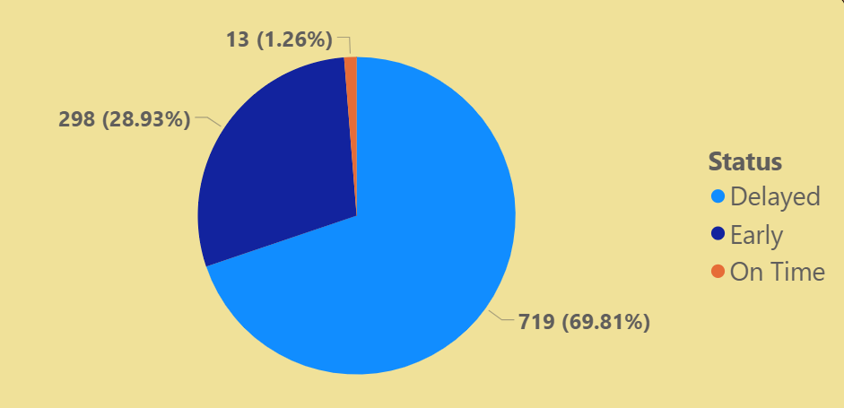
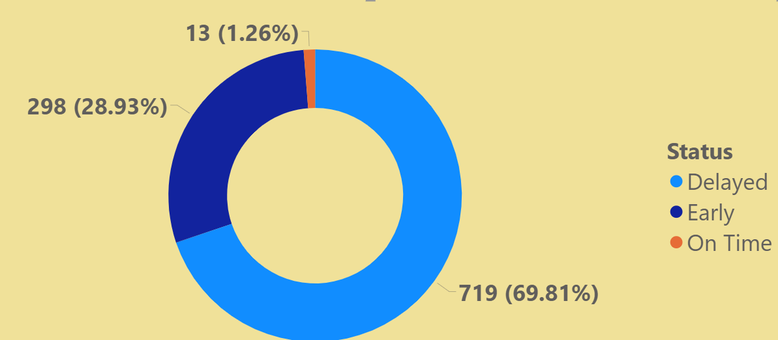
2) Pie Chart
Definition
A pie chart is a circular statistical graphic divided into slices to illustrate numerical proportion, where each slice's arc length, area, and angle are proportional to the quantity it represents. The entire pie represents a total of (100%), making it ideal for visualizing part-to-whole relationships with categorical data.
Key Characteristics & Best Practices
Purpose: Ideal for comparing parts of a whole (e.g., market share, budget breakdown) rather than comparing individual quantities.
Structure: Composed of a circle divided into sectors (slices) with labels, often showing percentages.
Limitation: Best used with a small number of categories; too many slices make the chart hard to read.
Variations: A donut chart is a variation that represents data in a ring rather than a full circle

Slide 18
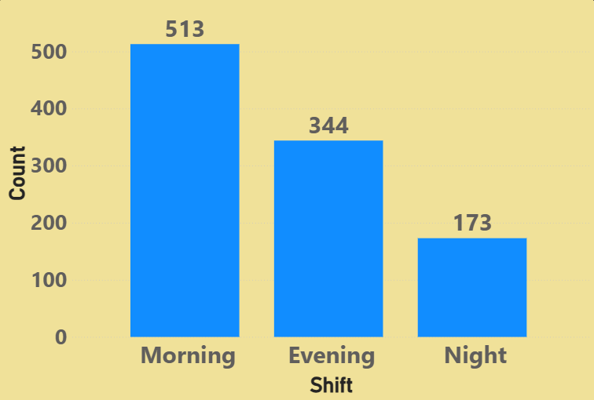
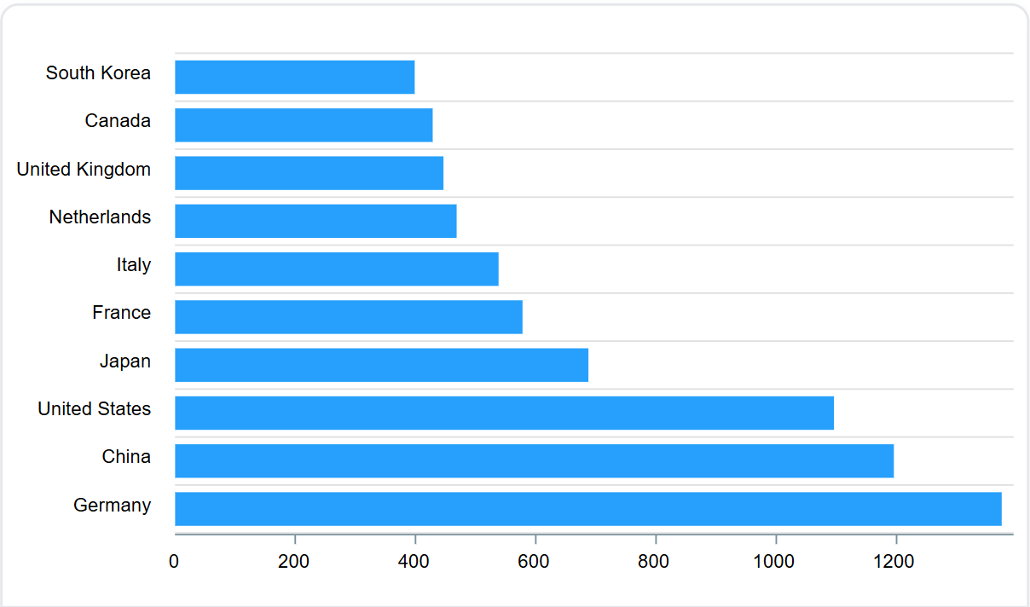
3) Column Chart
A column chart is a data visualization tool that uses vertical bars to compare numerical values across discrete categories or time periods.
It is highly effective for highlighting differences in proportions or trends over time, with the height of each column representing its value.
They are best for 10 or fewer items.
4) Bar Chart
The primary difference between a column chart and a bar chart is their orientation: column charts use vertical bars, while bar charts use horizontal bars.
Column charts are best for comparing fewer categories or displaying time series (left-to-right), whereas bar charts are ideal for long category labels or ranking large numbers of items.

Slide 19
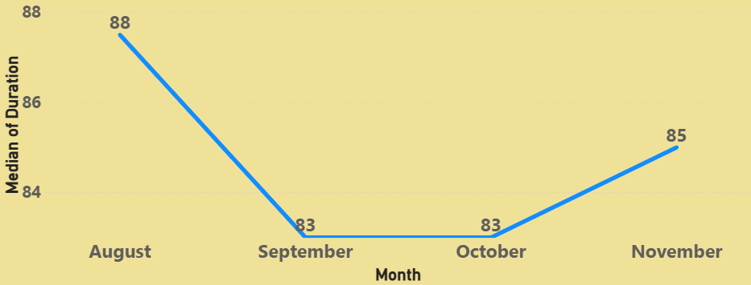
4) Line Chart
Line Graphs display quantitative values over a continuous interval or time.
A Line Graph is most frequently used to show trends and analyze how the data has changed over time.

Slide 20
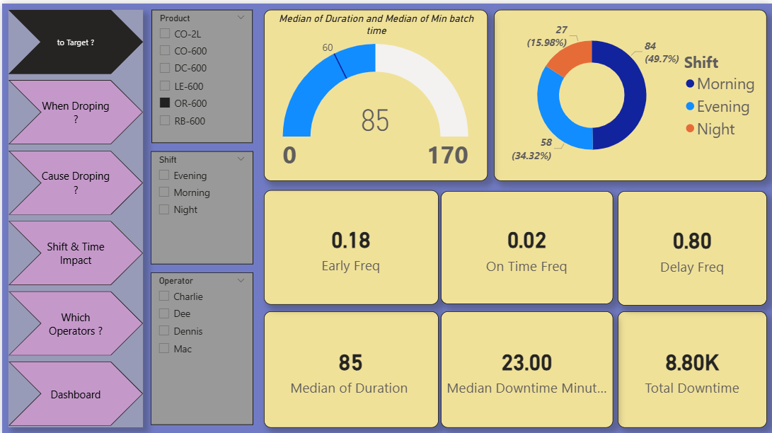
Measures

Slide 21
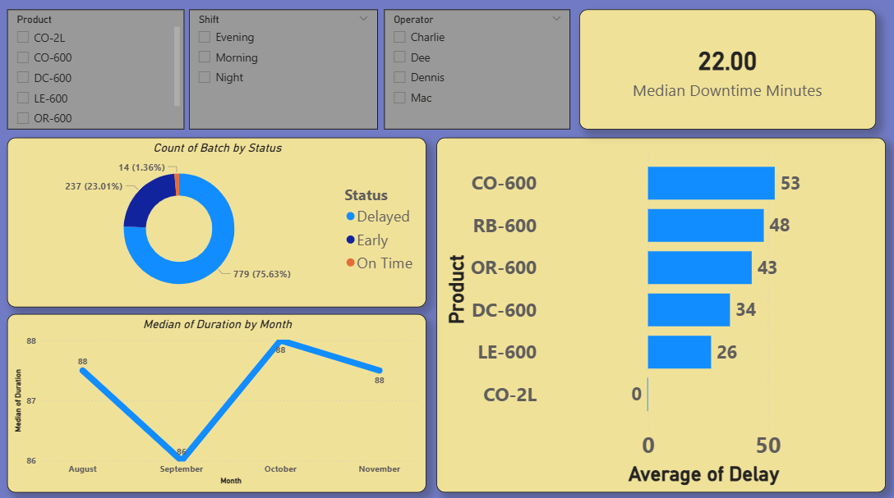

Slide 22
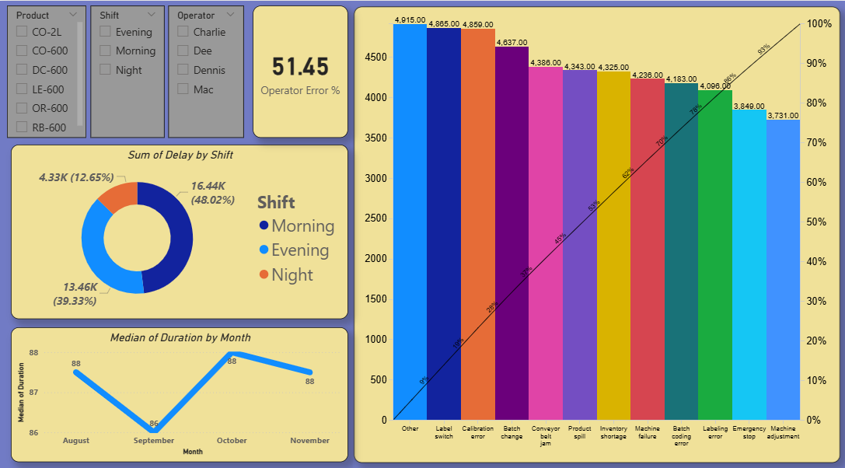

Slide 23
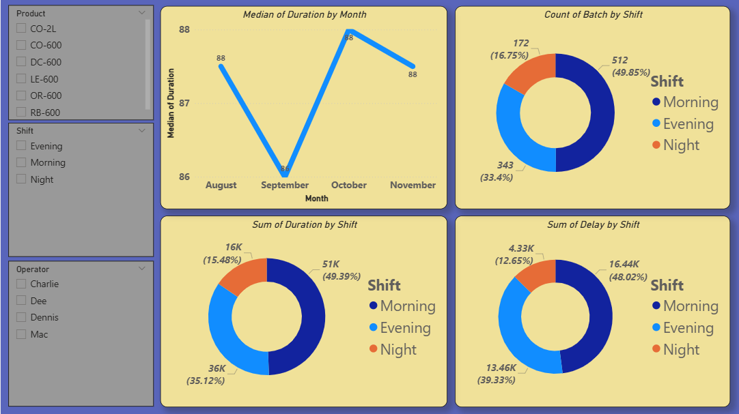

Slide 24
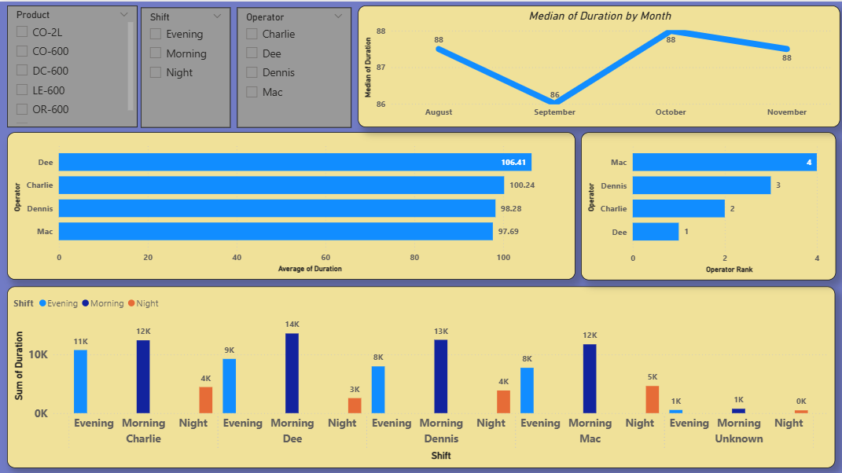

Slide 25
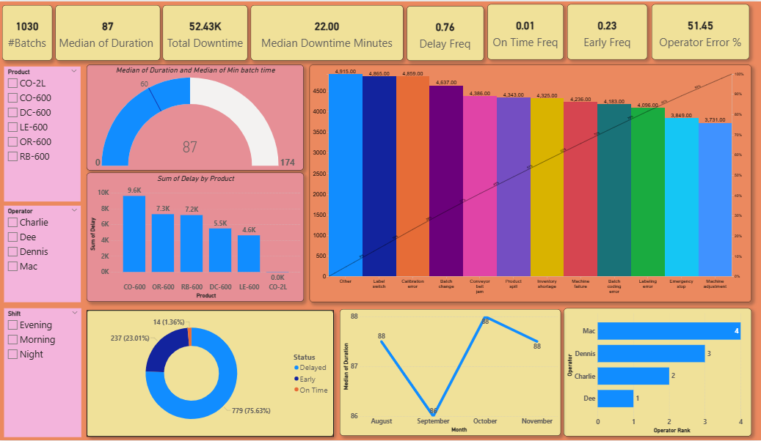
11) Dashboard

Slide 26
11) Insights
Key Insights
Production performance did not consistently meet the expected batch time, as many batches exceeded the standard production duration.
Production efficiency varied across shifts, with the Morning Shift showing better performance and lower average batch duration compared to other shifts.
The main causes of downtime were related to operational and process issues such as Label Switch, Inventory Shortage, and Machine-related interruptions.
Operator performance had a clear impact on production efficiency, as some operators achieved lower production duration and fewer delays than others.
CO-2L showed better overall performance with lower downtime and faster production compared to several 600 ml products, making it a strong example of efficient production conditions.
A small number of downtime factors contributed to a large portion of total production delays, indicating that solving key issues could significantly improve performance.

Slide 27

Thank You
GitHub Link

